Slide 1

DBMS PROJECT · FINAL REVIEW
Gym Membership & Fitness Session Management System
Design, working prototype, testing and documentation.
PRESENTED BY
ROLL NO.
SECTION
STACK
Aryan Baswapur
3007
BIC-Tigers-29
MySQL · JavaScript
Notes:
Final review for the Gym Membership and Fitness Session Management System — covering Review 2 (design, implementation, prototype) and Review 3 (final demo, documentation, viva).

Slide 2

DESIGN · NORMALIZATION
Every fact stored once — 3NF
In every table, all columns depend only on the primary key. Repeated details were split into their own tables.
Plans
Trainers
Attendance
Name and price stored once, not in every subscription.
Trainer details stored once; classes point to them.
Check-ins kept separate from bookings.
plan_id → name, price
trainer_id → name, specialty
attendance_id → check_in, check_out
Proof · No partial dependencies (single-column keys) · No transitive dependencies (non-keys never depend on each other)
Notes:
Each table has a single-column primary key, and every other column depends only on that key. So there are no partial dependencies (2NF) and no column depends on another non-key column (3NF). To get there, plan, trainer and attendance details were moved into their own tables.

Slide 3
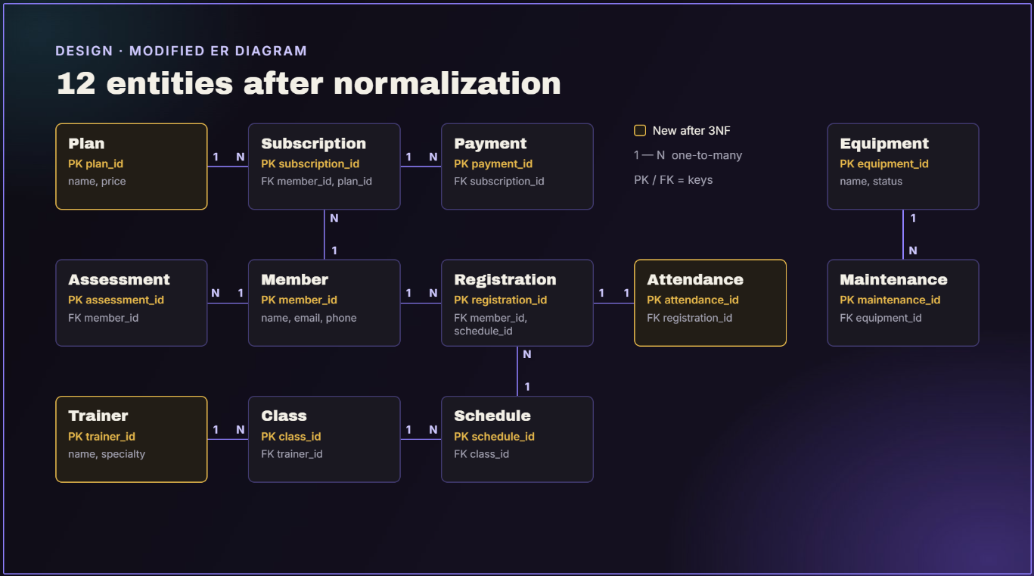
Notes:
Live demo: add a member, book a class, then try booking a full class to show it's refused cleanly.

Slide 4

REFLECTION
Challenges, learnings & next steps
CHALLENGES
LEARNINGS
FUTURE SCOPE
Rules that span many records
Triggers for complex rules
Online payments
Avoiding duplicate data
Normalization in practice
Automatic renewal reminders
Connecting the app to MongoDB
Views keep queries simple
Member mobile app
Notes:
The biggest challenge was rules that span many records — a simple check can't do that, so I learned to use triggers. Next steps would be online payments, automatic renewal reminders and a member-facing mobile app.

Slide 5
FINAL DEMONSTRATION
Live demo
Notes:
Live demo: add a member, book a class, then try booking a full class to show it's refused cleanly.

Slide 6
QUESTIONS & VIVA
Thank You
Aryan Baswapur
Roll No. 3007
BIC-Tigers-29
Notes:
Thank you. I'm happy to take questions for the viva.

